Slide 1
What is Data Science Anyway???
Jason E. Groom
jasongroom@ymail.com
https://jegroom.wordpress.com/
Deck Will Be posted on my WordPress site by EOD 5/12/15

Slide 2

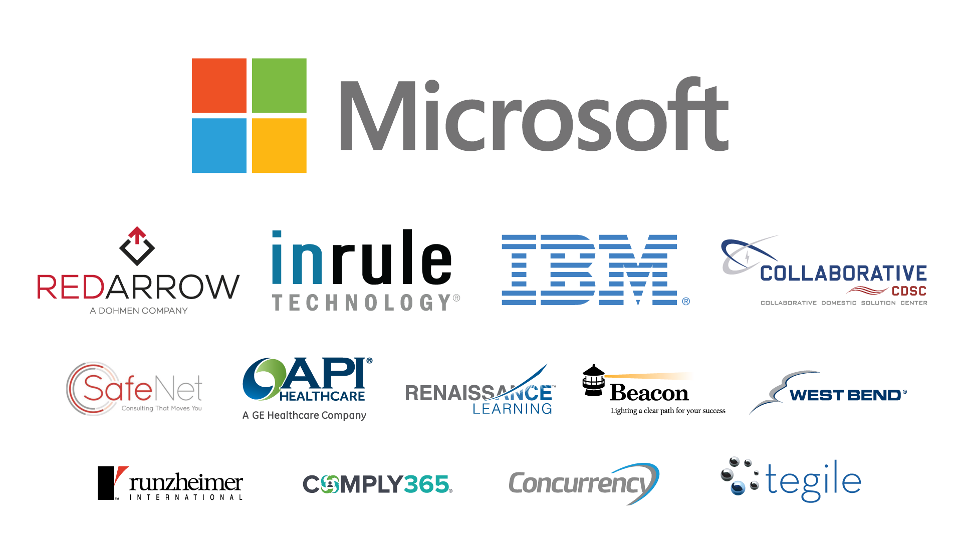

Slide 3
Who Am I?
I am a graduate of Loras College in Dubuque Iowa with a BS in Computer Science.
I spent the first part of my career as a software engineer, doing both development and test automation.
I have worked for IBM for the past 4 years, focusing specifically on Data Analytics.

Slide 4
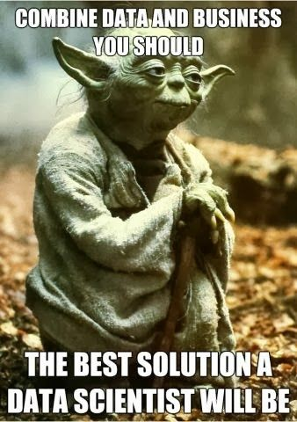
Yoda Says it Best!

Slide 5
Big Data is Big Business
In our world data is becoming more important every day.
It is estimated that 90% of the stored data has been generated in just the last 5 years. To put this in perspective, let’s break it down a little.
Every minute, on average:
2,000,000 Google Searches
27,800 Instagram Photos uploaded with 510,000 likes
278,000 tweets
1,875,000 Facebook Likes
208,000 Facebook photo uploads
6 new Wikipedia articles
204,000,000 Emails Sent (with 65% being spam)
$83,000 sold on Amazon
100 Hours of videos uploaded to YouTube
2,780,000 videos viewed on YouTube

Slide 6
The internet population now has over 2.1 billion people
For every website browsed, status shared, and photo uploaded, we leave a digital trail that continually grows the hulking mass of big data.
Now that we have all of this data, what do we, as scientists, do with it?
Big data is big business, not just for huge corporations, but for every business looking to move forward.

Slide 7
Agenda
What is Data Science anyway?
Why are Analytics important to business?
Who is my audience?
Where do I get data from?
I have my data, now what?
How to I present my data?
What is a visualization?
What tools could I use?

Slide 8
What is Data Science anyway?
Data Science - Buzz word, lots of different meanings...
Data Analytics
Business Analytics
Statistics
Big Data Research
All of these terms are just mean the gathering of data, and researching it from different points of view to make conclusions.

Slide 9
Data Sources
Data Science is the extraction of knowledge from data.
Data can come from Databases
Spread Sheets
Scribbles on a Napkins
Any source that you can gather meaningful, factual, and accurate information

Slide 10
Definition of Data Science
Data scientists investigate complex problems through
expertise in disciplines within the fields of mathematics,
statistics, and computer science. These areas represent
great breadth and diversity of knowledge, and a data
scientist will most likely be expert in only one or at most
two of these areas and merely proficient in the other(s).
Therefore a data scientist typically works as part of a team
whose other members have knowledge and skills which
complement his or hers.

Slide 11
What Does that Mean?
Data Science is just gathering data
Using mathematics and statistics to make computations
Creating hypothesis based on what the data says
Further using the data to either prove or disprove a hypothesis
Creating visualizations relevant to the data to help others, with a less intimate connection to the information, understand your conclusions and make decisions.
Working with others beyond your area of expertise to create a full picture of what the data represents.

Slide 12
Why are Analytics Important to Businesses?

Slide 13
According to the research firm IDC, the worldwide big data technology and services market will grow at a 27% compounded annual rate, to exceed $32 billion by 2017.
Organizations are becoming much more data driven, applying insights to everything from key business processes and decisions to the way they fundamentally operate. Rather than relying on decisions based on gut feelings, businesses are infusing analytics into everything that employees touch. Such as:
management systems
machine to machine processes
daily decisions and tasks
developing evidence-based cultures and workforces
Notes:
International Data Corporation

Slide 14
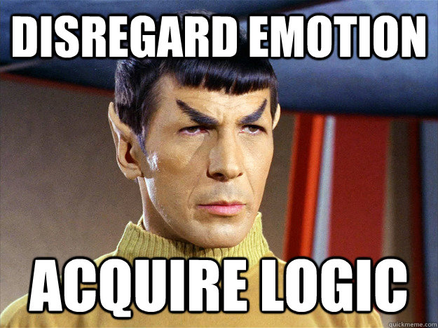
Why Not Rely on Feelings?
Can be misleading
No justification in logic for the decisions
Notes:
NiSource Anicdote

Slide 15
Sky Italia – Satellite TV Provider
This provider previously relied on data from cable boxes to understand what its customers were watching. After switching to digital platforms, Sky Italia was able to find new insights into viewing behaviors with big data and analytics.
They were able to create program schedules and on-demand content that was based upon social media data.
The data revealed the most popular shows based upon comments in social media.
The same data also allows the company to run targeted marketing campaigns, delivering more effective messaging to precise customer segments.

Slide 16
We are seeing a new ecosystem of startups, and developers, who want to accelerate innovation, creativity and an entrepreneurial spirit around cognitive computing.
This is an entirely new class of applications that will learn from experience, improve with each interaction and outcome, and assist in solving the most complex questions facing industries and society today.

Slide 17
An App that Learns!
Imagine if your application can learn from what your users are doing, in order to serve their needs better.
Shopping applications, such as Amazon, are a great example of this particular method in action. The application pays attention to what you look at, what you buy, and compare that to what everyone else using the app is looking at and buying, in order to show you items that you may not even know you need.
This is being employed by almost every online retail application, as well as some brick and motor stores.
That keychain you have full of store scan cards track every purchase that you make, and use that information to provide you with coupons that are likely to draw you back to their store.

Slide 18
Isn’t That a Great Idea?
Tracking what I buy in order to provide me with information about what I may need or want, sounds great, right?
In 2012 a major U.S. retailer used the information that they gathered to send coupons and targeted advertising to a pregnant teen. They used the data they collected, and made a determination of the young woman’s pregnancy prior to her informing her family.

Slide 19
The Catch!
Privacy invasion is a big concern that people have.
The more information gathered from more people, the better these types of applications are able to function.
That said, it means that we must allow those that we do business with to gather vast amounts of data about our buying habits, browsing habits, and other aspects of our lives for it to be useful.
This is one of the biggest controversies about big data research and data science. In order for it to be as useful as possible, we must allow our lives and habits to be monitored.

Slide 20
I Know I’m and IBM’er BUT…
One of the biggest new technologies being used for big data research and machine learning is the Watson system. It is being applied to multiple industries successfully:
medical research and diagnostic
Insurance actuary work
Cooking (Chef Watson)
Some of these are very serious business, and others are strictly for pleasure.

Slide 21
How Much?
Now a Watson system is a very large, very expensive system, and most companies cannot afford the luxury of this type of system, or others being developed that are similar to it.
That does not mean you are out of luck when it comes to machine learning and analyzing your data. Any system of reasonable power and storage can be used to return similar results. Obviously speed becomes the issue with systems of lesser power, but they can still be "Taught", and they can still return useful analysis.
The fact is that systems like this can be used to determine with, some confidence, many different things. Things from, is the server alert that you received likely a false alert, or is it truly a major system failure...to something as simple as I bought pancake mix, I might be interested some syrup...
Notes:
1. Imagine being able to give your doctor a list of your symptoms, and
he has access to every single medical journal produced in the last
several decades. Not only that, but a system that prevents them from
determine you have Ebola, when in reality you have a cold. The system
works based on probability, and confidence. It is reliant on doctors to
provide feedback so that it can learn and improve its diagnostic
process beyond its original programming.
2. Now imagine, you go to the fridge, you have an odd assortment of
ingredients, and no clue what to do with them. As a proof of concept
(Post Jeopardy) a Watson system was loaded full of nearly 100 years
of recipe data, and can accept new recopies from users at any time.
It also has in its DB listings of ingredients that are similar to each
other so that recopies can be modified to account for what you are
missing, or extra ingredients that you have in your supplies.

Slide 22
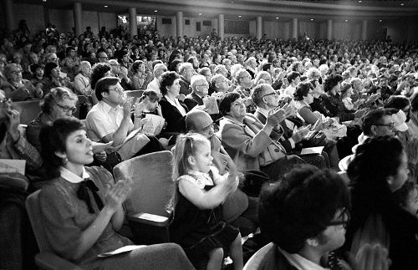
Who is my Audience?

Slide 23
One of the biggest things to remember when you are presenting your findings is, who is my audience?
Before you create a single chart or graph that you intend to share, putting some thought into who that visual will be seen by can dramatically improve your data visualization.

Slide 24
Let’s say that you are giving a presentation to a large group of high ranking executives in your business.
They most likely do not care about all of the small minute details of the average workers day.
Minor bugs, minor roadblocks and such.
They are likely more concerned with big picture information, and timelines.

Slide 25
Now let say you are presenting a status report to your team.
Those small detailed items may become much more important.
How many bugs are created per hour, or minor roadblocks
How we indented to breach them are also going to be very important to your smaller team.

Slide 26
And the Point is?
The point is, presenting the wrong level of information to a group of people is no better than presenting them no information at all
They need the information to make decisions relative to their position, decisions that they can have an make
Giving them information that is not relevant to them, may simply be frustrating.

Slide 27
Where Do I Get Data?

Slide 28
Data Is All Around Us!!!
Data can come from any source.
Many people get the idea in their head that data can only come from official sources.
Databases
Spread Sheets
Sometimes data can be much simpler. I have gotten some pretty interesting sources of data through my time as an analyst.

Slide 29
Emails - Not a bad source, harder to parse, but still useful.
Talking to individuals - Can provide good data, but can be clouded with "Feeling" rather than fact.
Napkins - probably the strangest source I have ever had
The point is that you can get data from everywhere. Though I would recommend sheets of paper over napkins!
Notes:
. I once had an issue, where I needed a count of a particular event. I informed the team I was working with that I needed data like this, but unfortunately it was not something that was included in their standard ticket data. The team agreed to provide me the information. I left them, and returned in an agreed upon time period, and was simply handed a napkin from the restaurant in our lobby with tick marks for each of the events. This provided me the information I needed to prove my hypothesis, and provide conformation of the solution that I helped them put into place.

Slide 30
I Have My Data, Now What?

Slide 31
Knowing what to do with the data that you have found, or been provided is a major challenge.
What hypothesis do you wish to prove, or disprove.
You need to have an understanding of what it is that you are looking to do.
Sometimes you have your data, and no clue what you are looking to prove or disprove.

Slide 32
This is where exploratory research comes into play!
You need skills and understanding of how to explore your data.
Exploratory research is looking for trends in data that you do not have an understanding of, or are not sure where issues, or opportunities may be.
There are lots of different tools out there that can help you in your exploratory research.
I will talk about some of some of these tools later, but most are quite simple, and some can be learned relatively quickly.

Slide 33
By Exploring the Data
You can get an understanding of the data.
Learn how it is organized
You can also identify trends in the data.
Identify issues where you may not have seen them before.

Slide 34
This process can take anywhere from minutes to days to find out if there are trends worth exploring.
If you do not find a trend, do not be discouraged. Sometimes there are none to find based on your initial hypothesis.

Slide 35
There are some tools that we can use, and types of visualizations that can help us look for trends in data.
One of my favorites is the process behavior analysis graph. It is a useful visualization that allows us to sort out statistically important points on a scale of time. Because it gives statistical limits, it provides extra insight into which data is statistically significant, and what data change is simply noise in the process.
Histograms can show us where the center of a data set lies, and how it progresses out from that center point.
You can slice, dice, and plot your data in any way that helps you analyze, and visualize your data. There is no wrong way to explore your data.

Slide 36
How Do I Present My Data?

Slide 37
Data is presented through visualizations.
Visualizations can come in many different forms.
Charts (similar to an extraction of excel data)
Not necessarily the best presentation, and it can be open to interpretation beyond what you have already done.
Charted data can be useful, if you have an audience who has the same comprehension of the data as you.
Graphs
Visually these are better for presenting data, as most people are more capable of understanding a graph. Graphs still have room for independent interpretation, but generally can be organized in such a way as to push your conclusions.
Graphs are generally going to be the best ways to present data to people that are not intimately connected to the data in the same way as you.

Slide 38
What Graph Do I Use?
Basic graphs such as line graphs, bar graphs, column graphs, pie graphs, are generally going to be of the best use to those who are not knowledgeable about graph types.
These types of graphs require little advanced understanding and are graphs that most average people learn how to understand when in school.
Sometimes they are not able to show more complex statistical concepts.
Scatter plots, box blots, histograms, Radar graphs, bubble graphs.
These types of plots can give far more information.
You need to be very careful using these types of graphs because they are harder to read and understand. Many people may not have seen these types before.
It is not terribly helpful if you need to spend the majority of your presentation explaining how to read a graph that you created rather than the data that it actually represents.

Slide 39
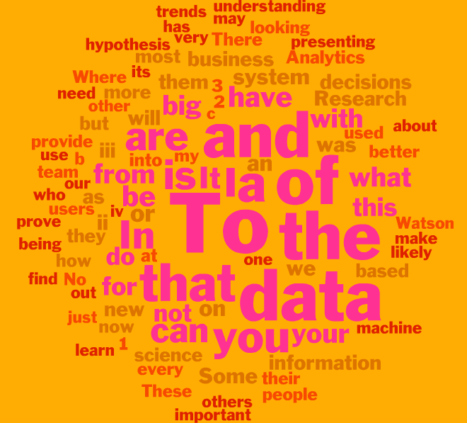
graph Examples

Slide 40
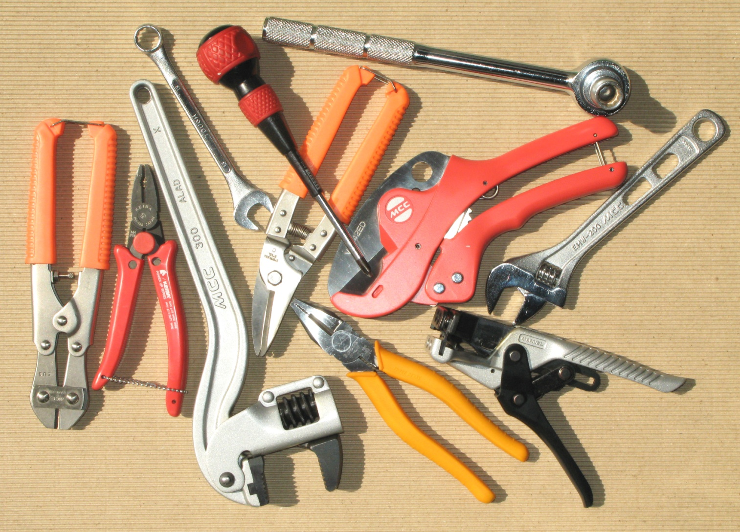
Tools?
So Many to Choose From

Slide 41
Excel
Easy to use to a point
Lots of people already have experience
Limited file size
Slow when working with large data sets

Slide 42
S Programming
Long history with lots of documentation
Can handle large Data Sets
Easy for developers to learn
Ability to create packages if one does not exist.
Easy to create visualizations
Easy to create graphs
Ability to slice data easily
Create and run saved programs
Work live with data.
Is not open source and does have a cost to use

Slide 43
Python
Free
Convenient for developers to learn
Large user base
Not specifically designed for analytics.

Slide 44
Watson Analytics
Currently Free Service (May not stay that way)
Under constant development, and may change at any time.
Requires registration
Must agree to have your data stored for research and development purposes

Slide 45
R Programming
Huge developer base
Free to use
Easy for developers to learn
Practically unlimited packages
Ability to create packages if one does not exist.
Easy to create visualizations
Easy to create graphs
Ability to slice data easily
Create and run saved programs
Work live with data.
Long history with huge amounts of documentation

Slide 46
Wrap Up
You may not all want to devote your careers to data, but everyone should have a basic understanding of what the vast amounts of data can do for them.
Data is out there for nearly every aspect of our lives, and our businesses, we might as well use it!!!

Slide 47

QUESTIONS?

